Slide 1

The seductive diversion of solving bias in Machine Learning3
Kritika Chugh
Computer Science and Engineering

Slide 2
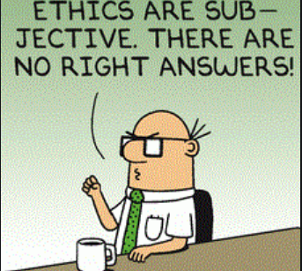
How Often do we ask the right question?
Are we trying to fix something that is already broken?
Some may say - We are trying to incorporate a trend of seeing AI without bias. Are we distracting ourselves and de-railing us from solving more important questions about solving more problems at hand?
We are talking about private gains vs societal cost here.

Slide 3
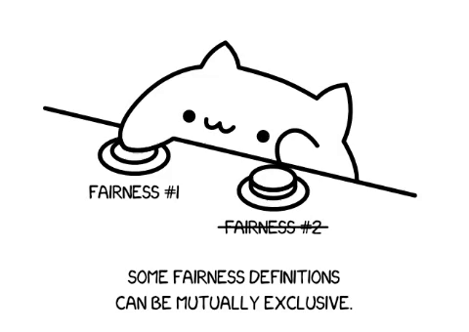
The diversion, seduction and reality
Great minds and serious thinkers in academia and business want to and are eager to improve the data and algorithms that drive AI but the problem they see mainly is of fairness and have latched on to it.
The reality is that even though we formalize some conditions for a probabilistic classification to be fair to the different groups, then also there is no method that can simultaneously satisfy all the conditions. This is sometimes also called as Impossibility theorem of fairness.

Slide 4
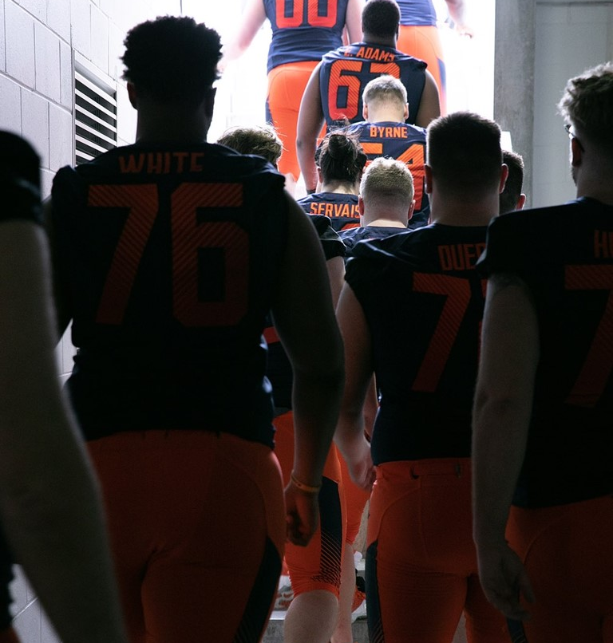
The challengers?
They are asking the questions that companies as the likes of FB / alphabet do not like you to ask as it stifles their work in the AI
The Serious thinkers in academia and business have now started question AI ‘s Bias problem.
Why? - It affects their work ethics and credibility of the trade and organization.
“When technological advancement can go up so exponentially, I do think there’s a risk of losing sight of the fact that tech should serve humanity, not the other way around.” – Tim Cook
Notes:
Tim cook (the apple CEO) in a very famous exclusive interview talked about AI in iPhones and why he does not want to talk about the future. He acknowledged how AI is well integrated in the phones we use. (image recognition in the photos, apple music learns what you have been listening to and adjusts recommendations accordingly, even the battery now serves us longer by understanding the usage). These are some of the things that profoundly helping us.)
By this way they have subdued a bigger challenge – which is bias in this case, even though all that has been done is to slice and dice and redistribution of those who the most affected by these algorithmic decision making.

Slide 5
“The Awe and Shock”
They are making people ask these questions as well and they are in “awe and shock”.
Although we live in a world full of bias, AI does quantify it
It amplifies racial, gender, and class inequality.
Given our current deference to technology and contemporary exaltation we are in a state of awe always.

Slide 6
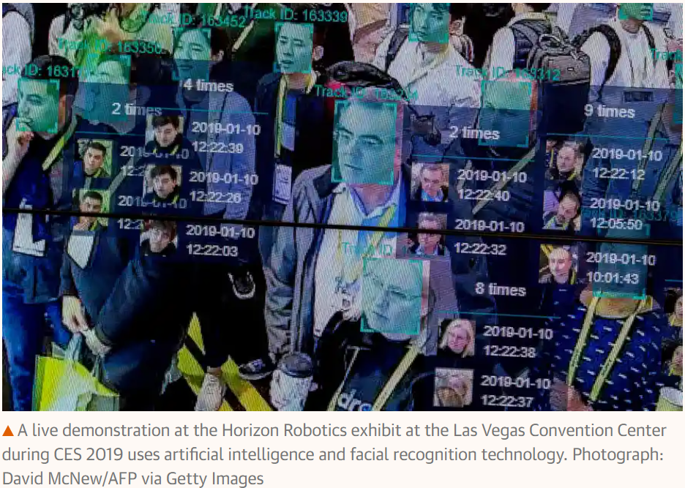
A Live demonstration at Horizon Robotics Exhibit
(Las Vegas Convention Center, CES 2019 – using AI and facial recognition technology)

Slide 7
Limited Imagination of ethics, media and law.
Technology has grown from some devices and platforms we use to an entire environment in which we function. For decades tech have defined us. They are a cultural phenomenon now and it has its problems.
If I purely talk out of computational fairness, then we are ignoring other problems too. And those problems cannot be tackled by engineering.
I want to emphasize that it has limited the entire imagination of ethics, media, and law. How?
Obscuring bias’s root cause – addressing bias just as a computational problem prevents other perspective of looking it as a social problem too. Seeking it to solve within the logic of algorithm is going to be inadequate. Having said that, it can and should be removed in the algorithms we design.

Slide 8
The “AI inevitability” and “AI bias” – a twin story
The following narrative is often sold to us:
AI bias narrative: Bias becomes a part of the grand bargain of innovation just like job losses and safety hazards.
AI Inevitability narrative: by accepting the above narrative we give rise to inevitability.
It absorbs all bad things – a) classification practices, b) underlying system of inequality perpetuated by automation. And as a result, even a small but relatively increase in fairness would be claimed as victories.
Notes:
https://www.bostonmagazine.com/news/2018/02/23/artificial-intelligence-race-dark-skin-bias/
(What these victories will essentially do is to bring the AI to the positive limelight all over again.)
By this way they have subdued a bigger challenge – which is bias in this case, even though all that has been done is to slice and dice and redistribution of those who the most affected by these algorithmic decision making.

Slide 9
The end game id to “fix” AI systems, never to use a different system or no system at all.
AI is backed by real-world forces of money, power, and data.
There is a broad Political and economic context to it.
  Political context – gaining power.
  Economic context- AI is minting money for the big companies.
Some of the prominent voices do sound alarm. Some genuinely are concerned about how it shapes the society and some just do it with blessings and support from the likes of the Facebook, Microsoft etc.
Being progressive, they do spotlight important questions (short term) but being private-entities they also make sure to divert the attention from the long-term challenges.
Notes:
(My thought on this is that – they want you talking but talking about bias. Then they will work on it relatively better than society and sell it as victory to you. By doing so we have made sure that we are not asking about – * smarter data policies, *who controls this vast data.
As these questions bring the attention to the monopoly these companies hold on data and even the policies surrounding them.)
“The mentality is, ‘If we can do it, we should try it; let’s see what happens,” he added. “‘And if we can make money off it, we’ll do a whole bunch of it.’ But that’s not unique to technology. That’s been happening forever.’”

Slide 10
Vast troves of data and who controls them?
Smarter data policies:
our governors and communities should act decisively to disincentivize and devaluate data hoardings
Creative policies and carefully designed laws defining bans, levies, mandated data sharing and community benefit.
Benefits and exciting challenges:
Would reenergize the competition and innovation (this have been unquestionably being slowed down by the market power of the tech giants.)
An opportunity to take up to the challenge to build robust process for solving fundamental existential question.

Slide 11
Opinion on laws
Possibility to stop the use of automated systems which comes with appreciable society cost. (Democracy)
They are there to give genuine accountability mechanism (external to companies and more accessible to population)
Personal thoughts : any AI system that is integrated in our lives must redress our interest not work against us)

Slide 12
Who are affected?
Answer is almost ‘EVERYONE’.
We see examples of
Delivery services skipping poor neighborhood.
Online ads showing higher paying jobs to men.
Facial recognition system that fails people of color.

Slide 13
Final Thoughts
Despite limited implementations AI can be only as good as humans can be. (who program and test it.)
It has its advantages too and I leave it to discussion to decide which side are you on?
Do you want to be a part of this mass experiment on humanity, or do you want to opt out of it?
Are we ready for the grand bargain?
And if yes, then is it worth it?
And if yes, do not forget to think about – Who is on the other side of the bargain?
My thoughts : I feel there are other grave concerns that can be brought about and discussed such as autonomous weapons and their safe deployment in the hardware devices. I feel we already are using more of such technologies and therefore shift should be towards talking about other problems too such as regulations, co-operations, transparency and ethical data collection methodology.
Additionally, to top all we need to be transparent to the very least with the end user about various metrics used in the algorithms.
Notes:
(While it may not be possible to have completely unbiased human being as we do these bias both consciously and unconsciously to some degree and that is why in my opinion it would be hard to make one unbiased AI algorithm). (So, focus should be on to building an AI that do better than it is today.)
AI is a business
and if you are using it, you are succesptible to be an integral part of someone's business which is data mining or data analysis. We have seen companies operating within the socila media universe and collecting data, simple data and then using it to monitor us, sell us products and services or may be to further their business. We are the customers and the laborers. The government is not geared up to help the people in many countries upon any contention between these companies and our privacies.

Slide 14
Sources and References
https://dilbert.com/strip/2013-07-25
https://innovation.defense.gov/ai/
http://medium.com/

Slide 15

Thank You!3
Kritika Chugh
Student – College of Engineering and Computer Science, Syracuse University
SUID: 8882155566

